Slide 1

Chapter 7
Transmission Media
Copyright © The McGraw-Hill Companies, Inc. Permission required for reproduction or display.

Slide 2
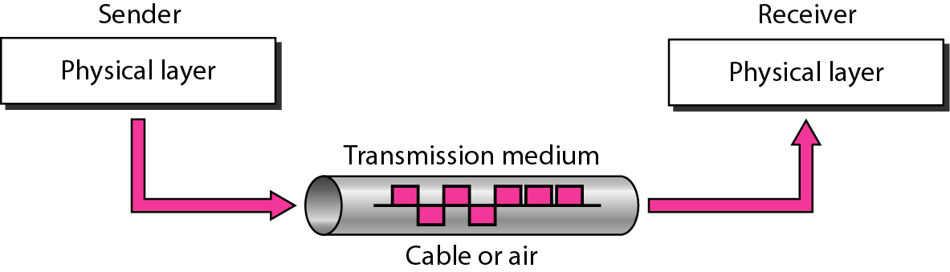
Figure 7.1 Transmission medium and physical layer

Slide 3
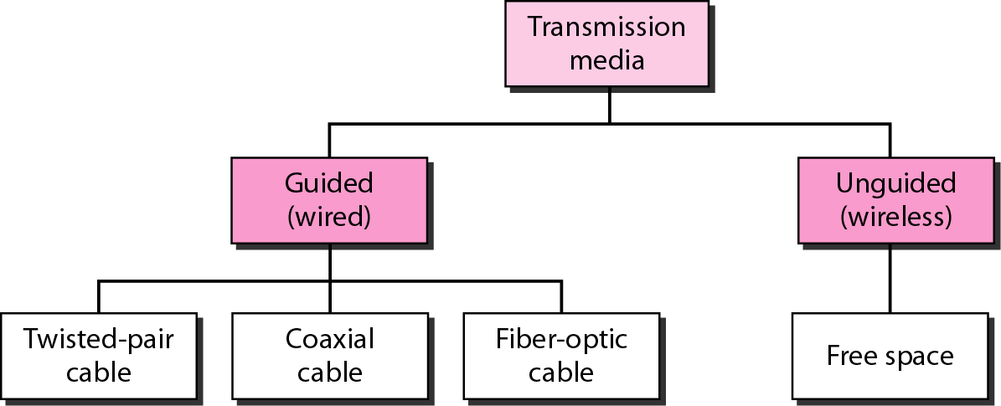
Figure 7.2 Classes of transmission media

Slide 4
7-1 GUIDED MEDIA
Guided media, which are those that provide a conduit from one device to another, include twisted-pair cable, coaxial cable, and fiber-optic cable.
Topics discussed in this section:
Twisted-Pair Cable Coaxial Cable Fiber-Optic Cable

Slide 5

Figure 7.3 Twisted-pair cable

Slide 6
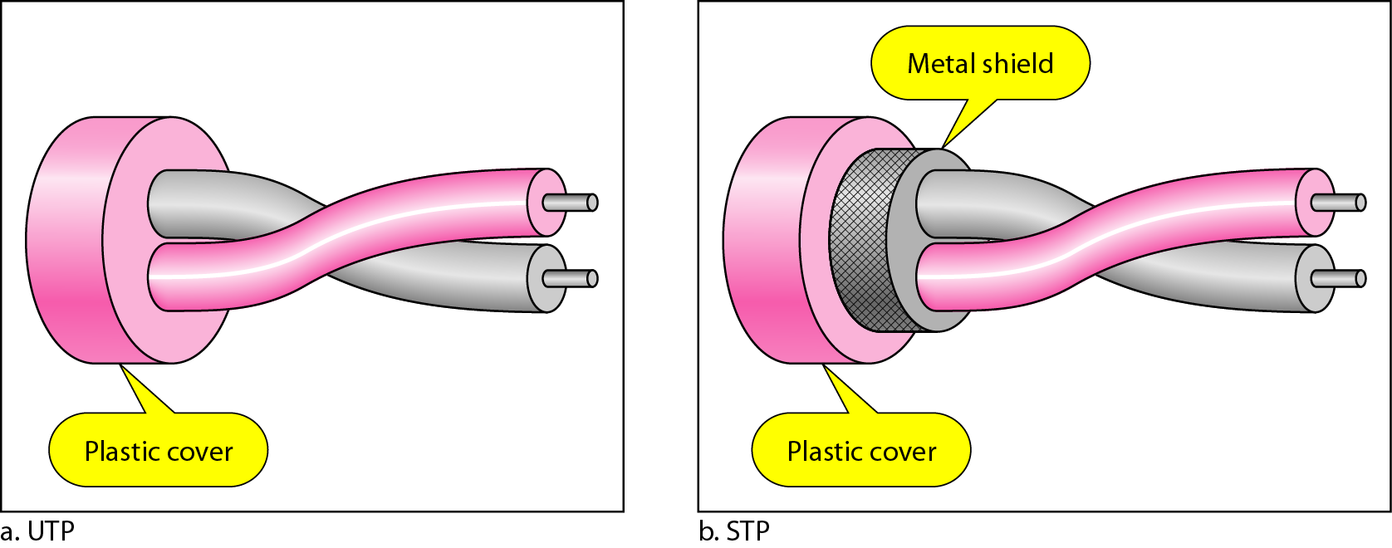
Figure 7.4 UTP and STP cables

Slide 7
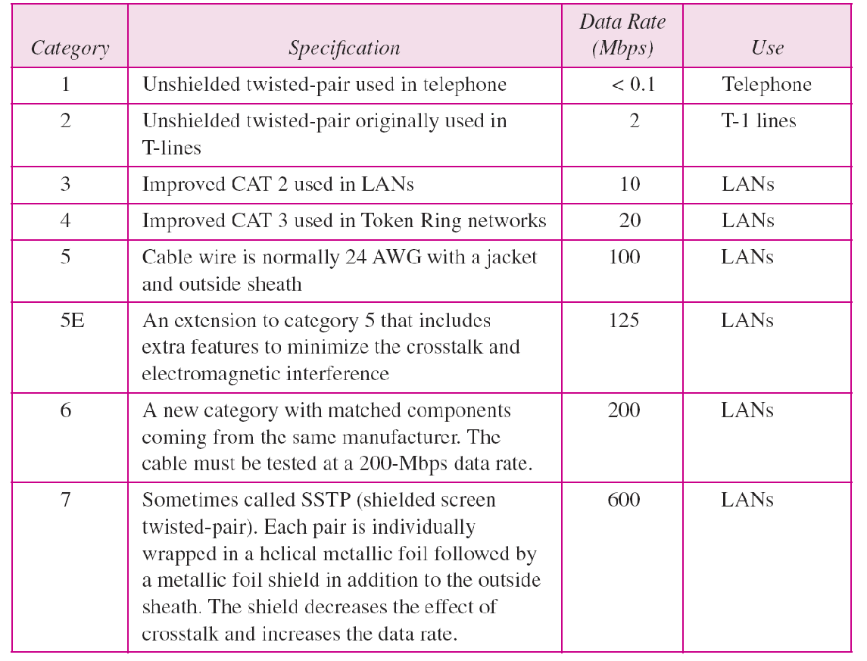
Table 7.1 Categories of unshielded twisted-pair cables

Slide 8
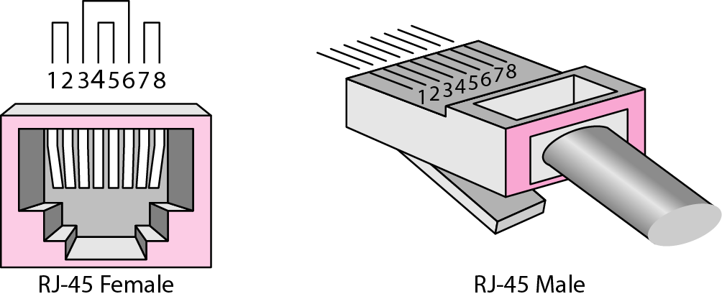
Figure 7.5 UTP connector

Slide 9
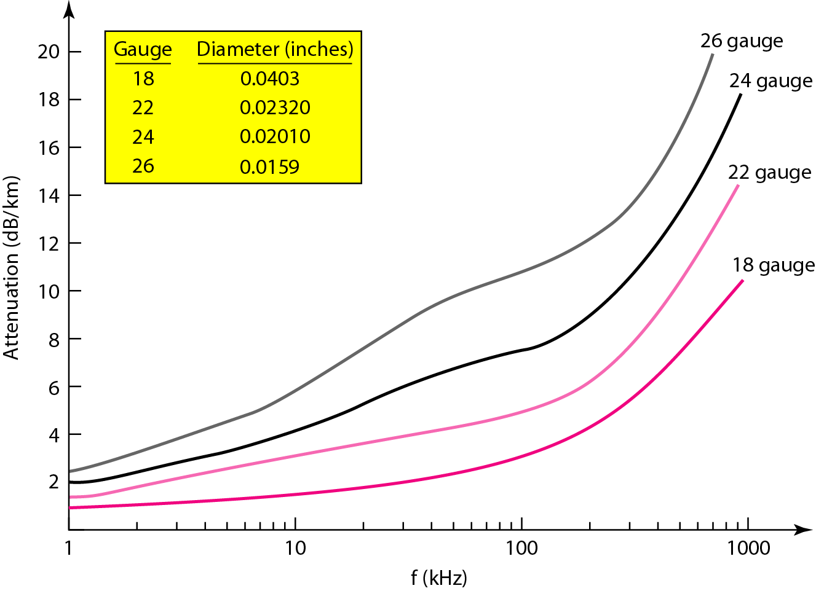
Figure 7.6 UTP performance

Slide 10
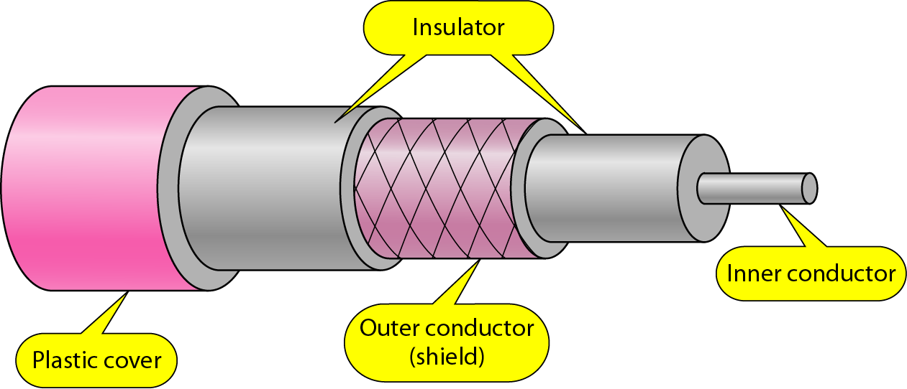
Figure 7.7 Coaxial cable

Slide 11
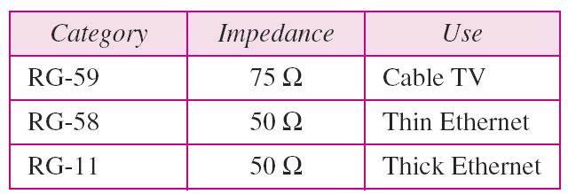
Table 7.2 Categories of coaxial cables

Slide 12
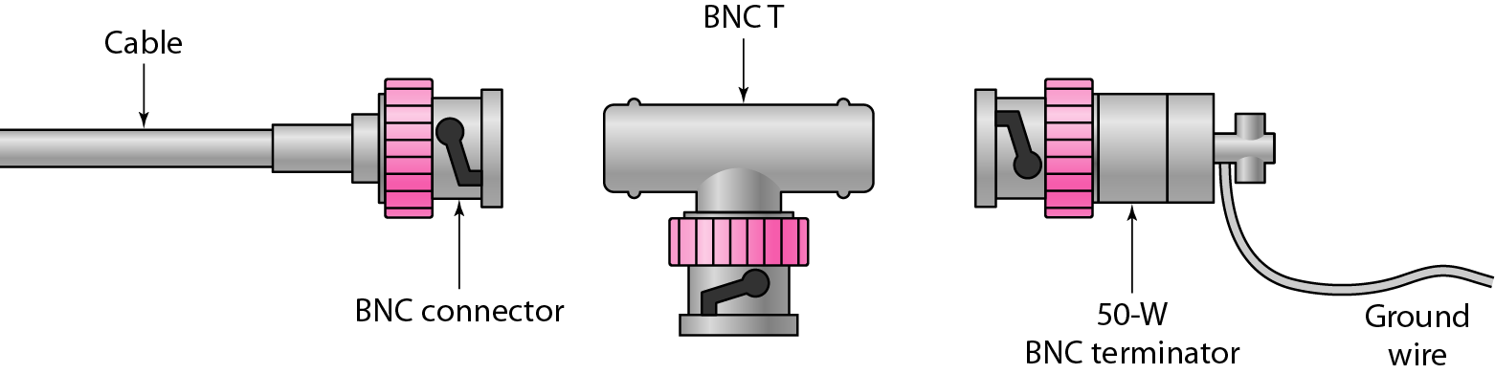
Figure 7.8 BNC connectors

Slide 13
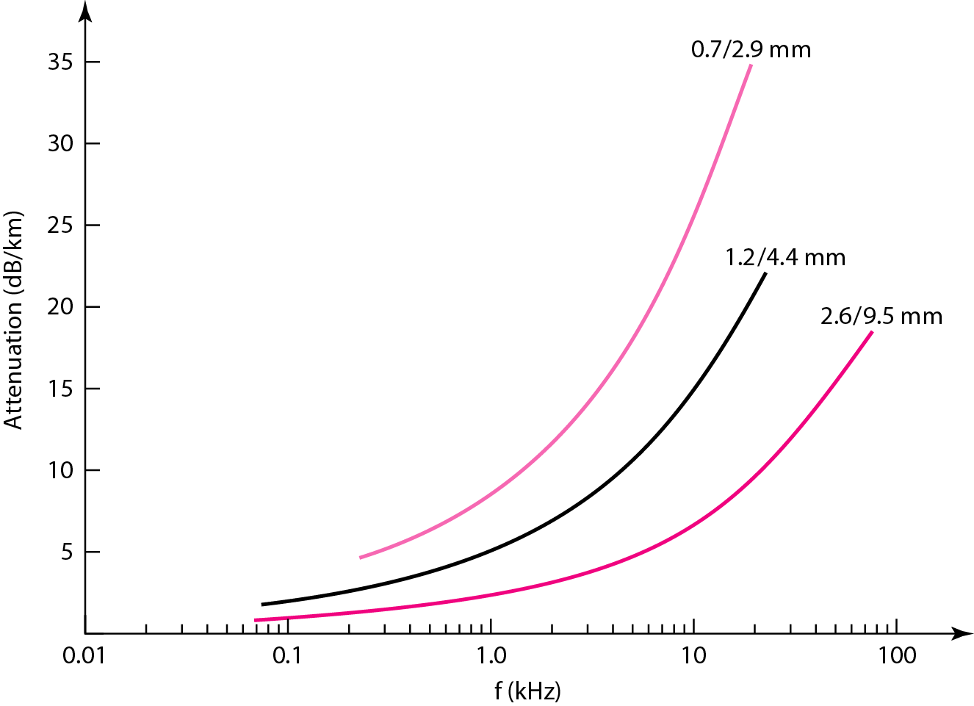
Figure 7.9 Coaxial cable performance

Slide 14
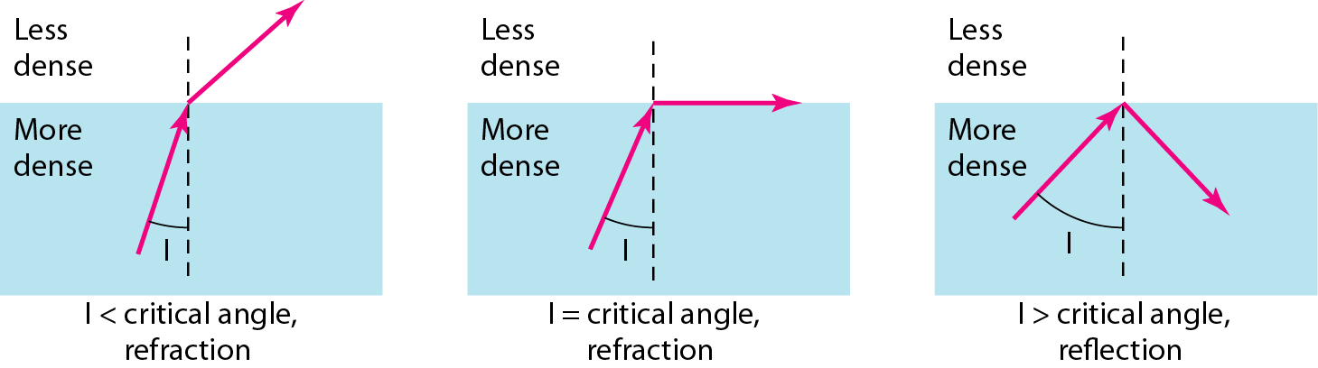
Figure 7.10 Fiber optics: Bending of light ray

Slide 15
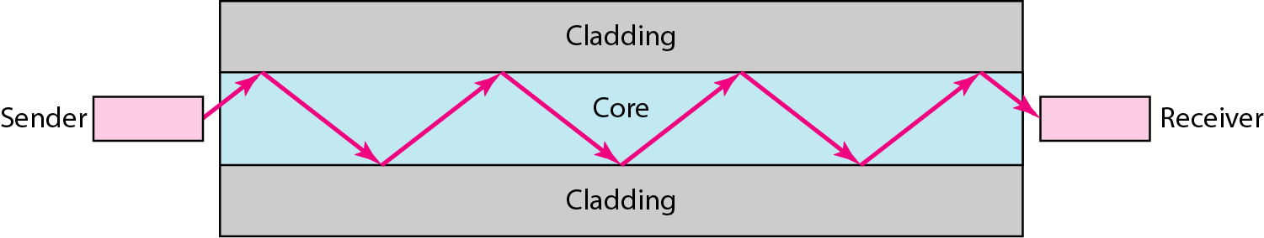
Figure 7.11 Optical fiber

Slide 16
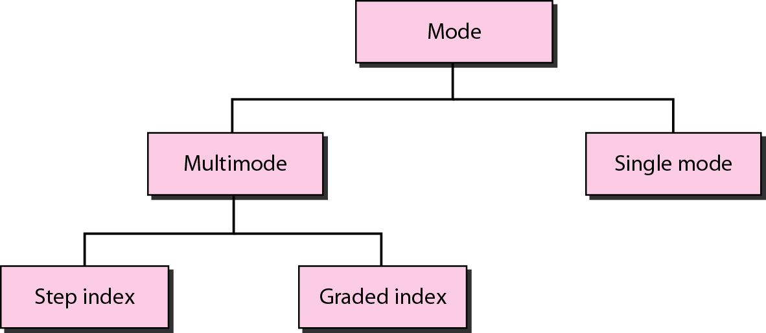
Figure 7.12 Propagation modes

Slide 17
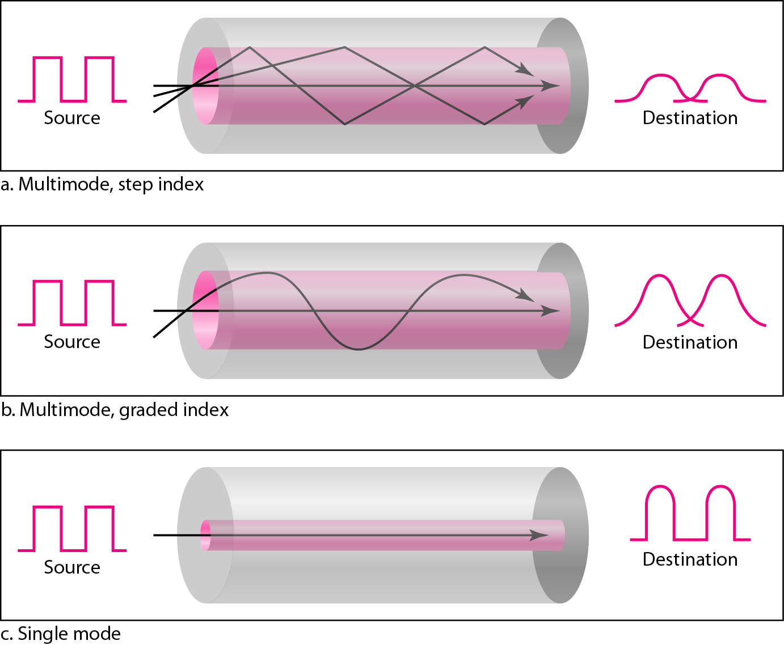
Figure 7.13 Modes

Slide 18
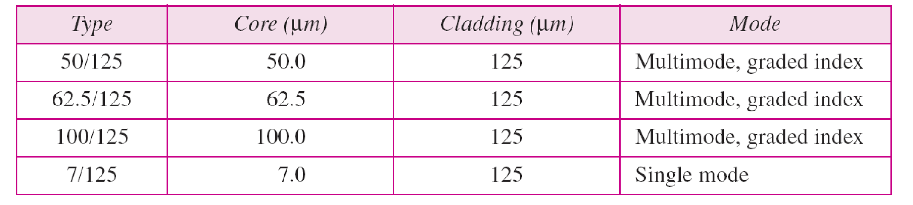
Table 7.3 Fiber types

Slide 19
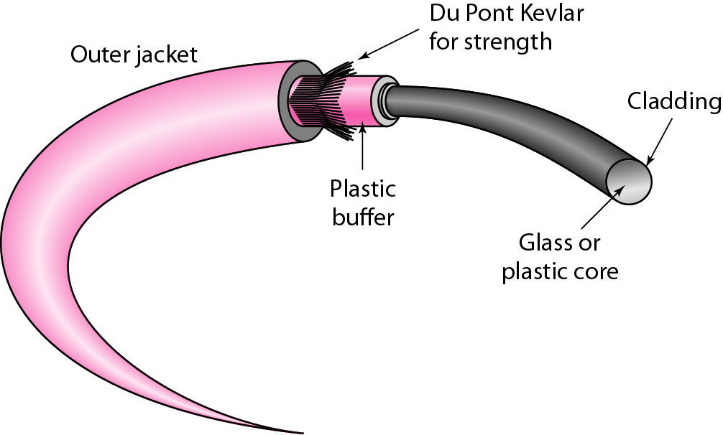
Figure 7.14 Fiber construction

Slide 20
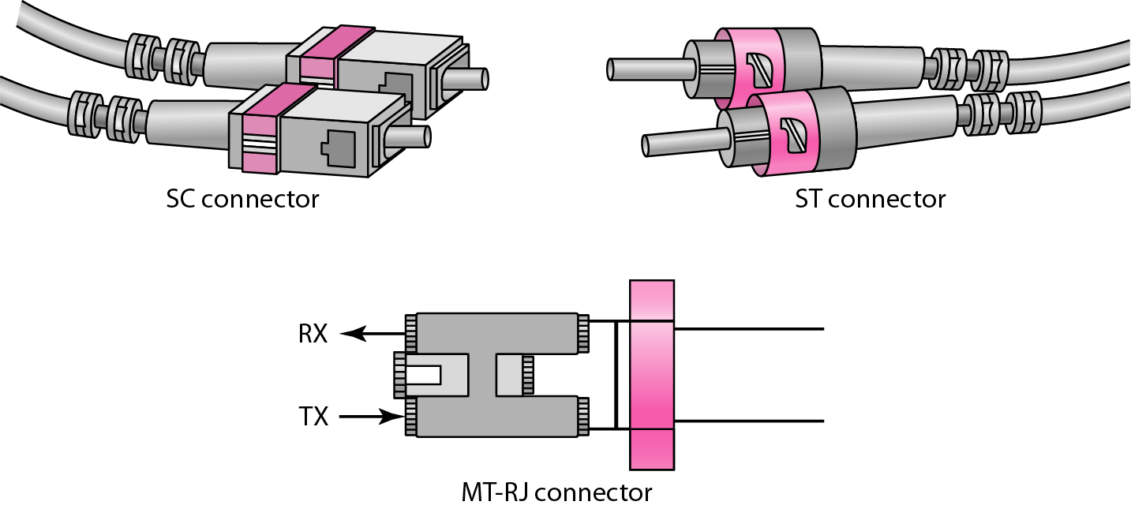
Figure 7.15 Fiber-optic cable connectors

Slide 21
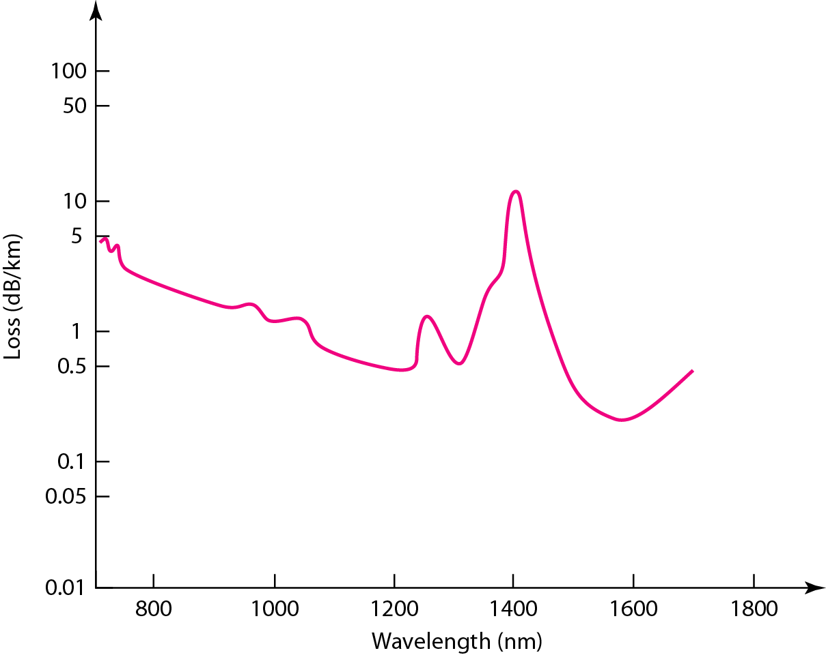
Figure 7.16 Optical fiber performance

Slide 22
7-2 UNGUIDED MEDIA: WIRELESS
Unguided media transport electromagnetic waves without using a physical conductor. This type of communication is often referred to as wireless communication.
Topics discussed in this section:
Radio Waves
Microwaves
Infrared

Slide 23
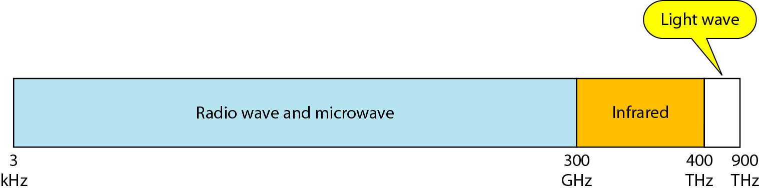
Figure 7.17 Electromagnetic spectrum for wireless communication

Slide 24
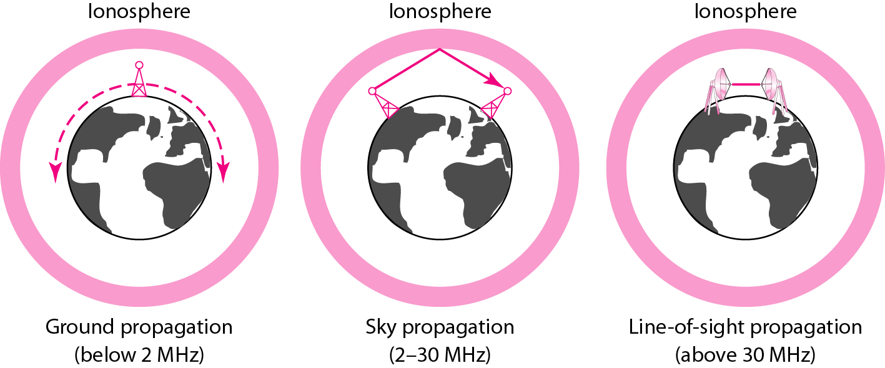
Figure 7.18 Propagation methods

Slide 25
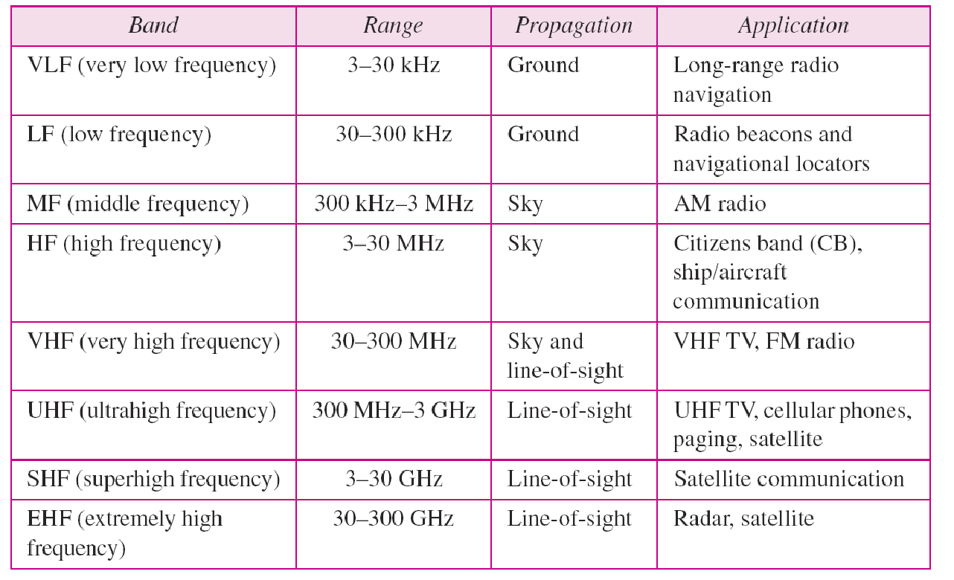
Table 7.4 Bands

Slide 26
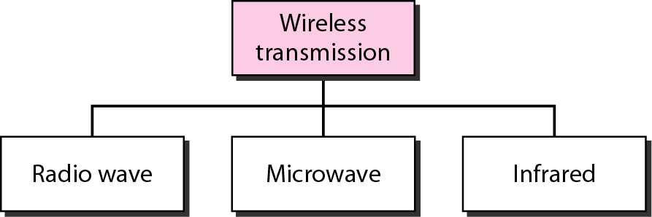
Figure 7.19 Wireless transmission waves

Slide 27

Note
Radio waves are used for multicast communications, such as radio and television, and paging systems. They can penetrate through walls.
Highly regulated. Use omni directional antennas

Slide 28
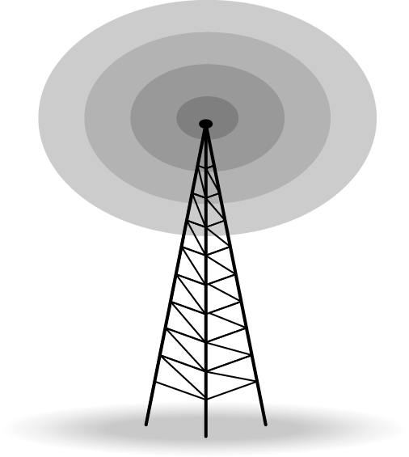
Figure 7.20 Omnidirectional antenna

Slide 29
Note
Microwaves are used for unicast communication such as cellular telephones, satellite networks, and wireless LANs.
Higher frequency ranges cannot penetrate walls.
Use directional antennas - point to point line of sight communications.

Slide 30
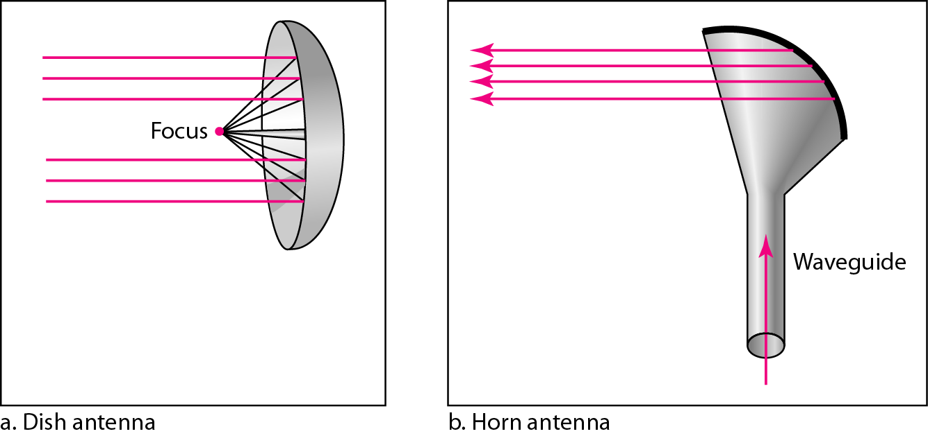
Figure 7.21 Unidirectional antennas

Slide 31
Note
Infrared signals can be used for short-range communication in a closed area using line-of-sight propagation.

Slide 32
Wireless Channels
Are subject to a lot more errors than guided media channels.
Interference is one cause for errors, can be circumvented with high SNR.
The higher the SNR the less capacity is available for transmission due to the broadcast nature of the channel.
Channel also subject to fading and no coverage holes.

